Slide 1
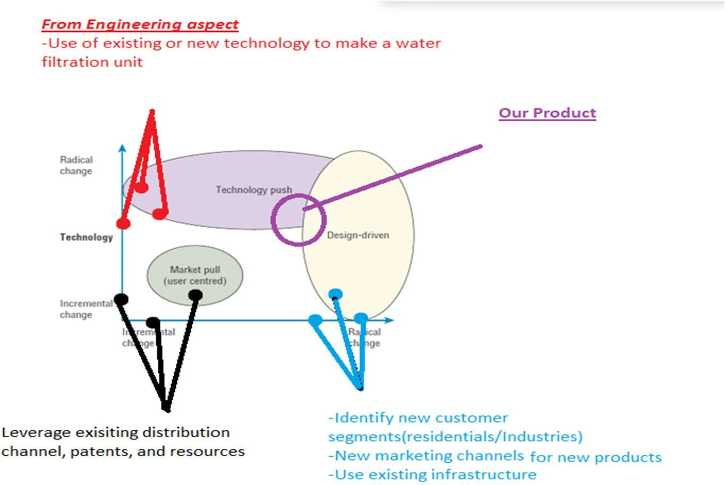


Preliminary Design Review
for the
Portable Micro-plastic Water Filtration ^{(Group-6)}
3M United States Division
OSAPO Team: Piyush Bhardwaj, Melissa MacLiesh, Thomas Preetham, Sankalp Saoji
Purpose: To approve…
Confirm orientation to the NPD Charter
Make sure product aligns to management’s goals
‘Green light’ starting production
Resource allocation and support for development

Slide 2
Contents
Project Overview
Creed
Filter
Concept Freeze
Product & Components
Development Plan
Cost Categorization
Resource Utilization Matrix

Slide 3
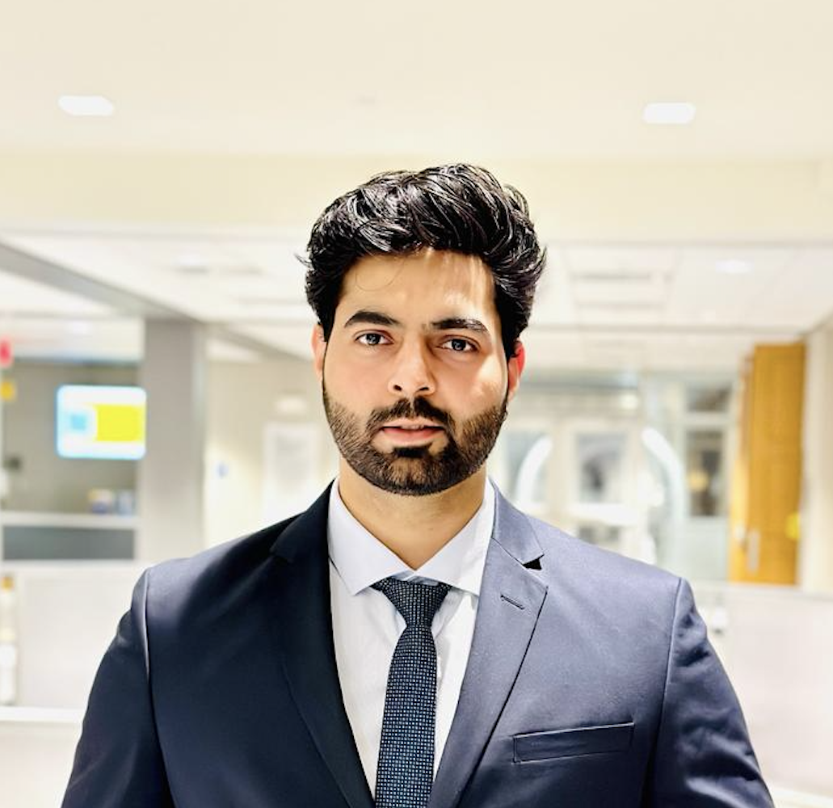

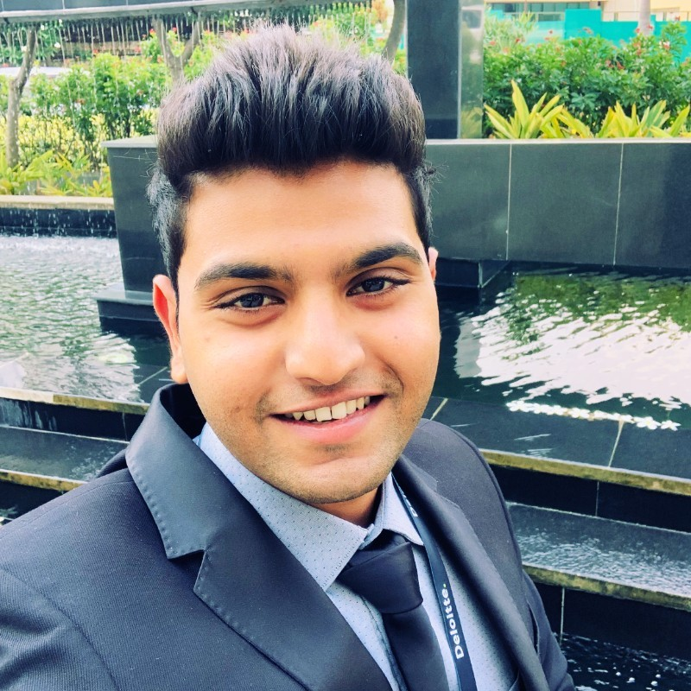

Project Overview
Group:
Water Filtration Business Unit at 3M
About the Company:
3M - Largest water filtration company in the US Made 32 billion dollars in revenue last year. Focused on providing water to residential places
About the Product: Biodegradable water filter for filtering microplastics in residential and
school settings
About the Team:
Piyush Bhardwaj
Director of Product Development
Melissa MacLiesh
Head of Marketing
Thomas Preetham
Principal – Research & Development
Sankalp Saoji
Principal – Engineer

Slide 4
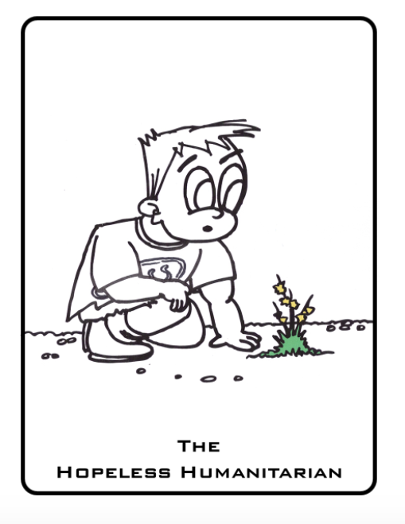
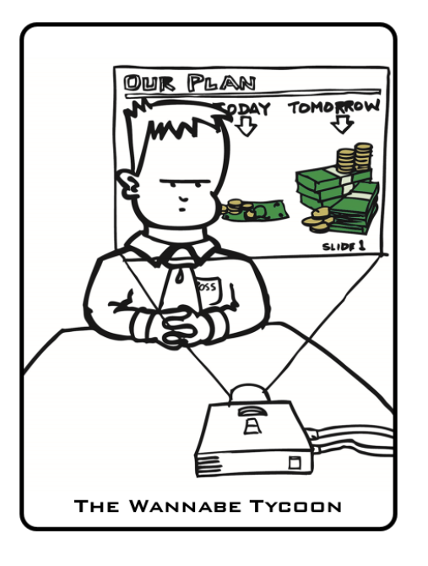
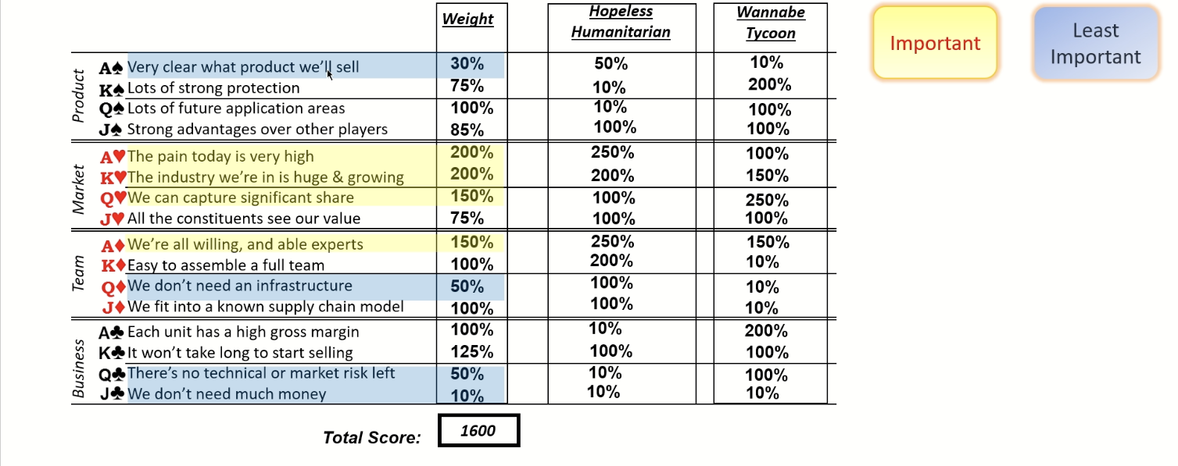
Creed
Portable Micro-plastic Water Filtration

Slide 5
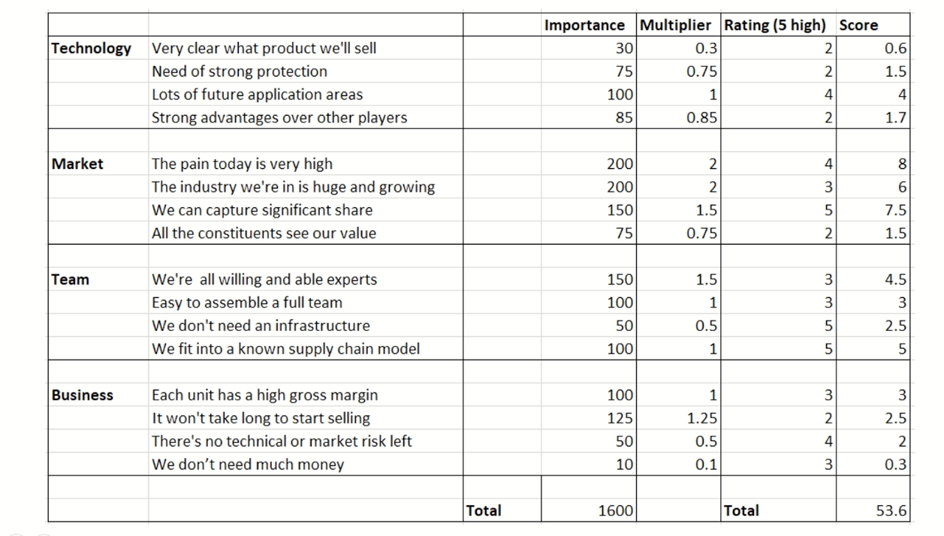
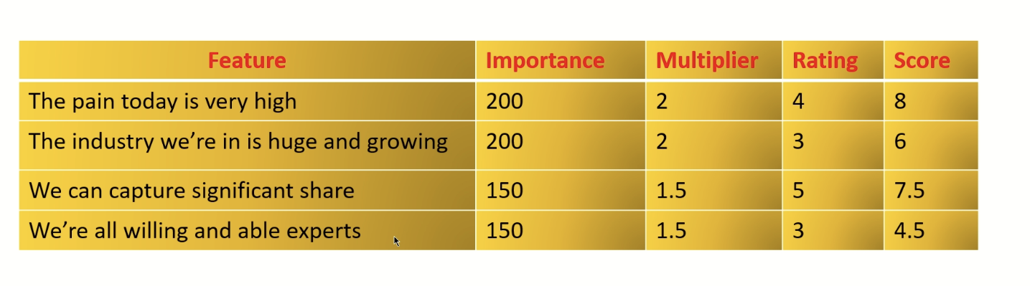
Filter
Full Filter
Mini Filter

Slide 6
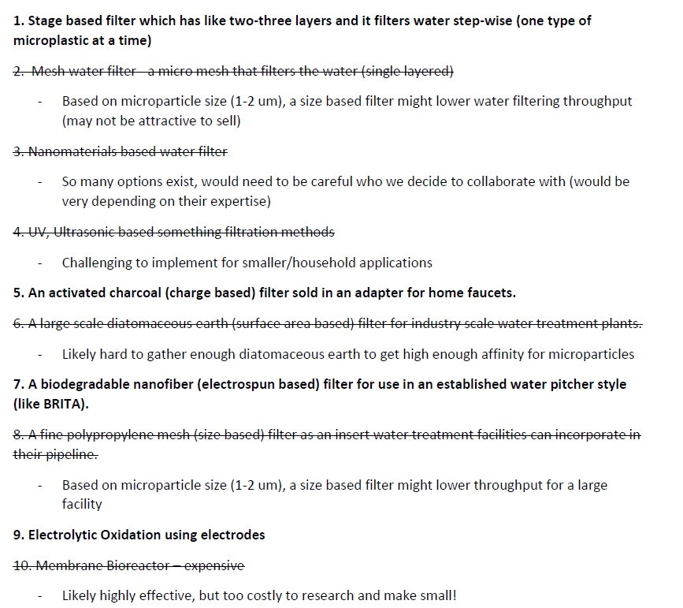
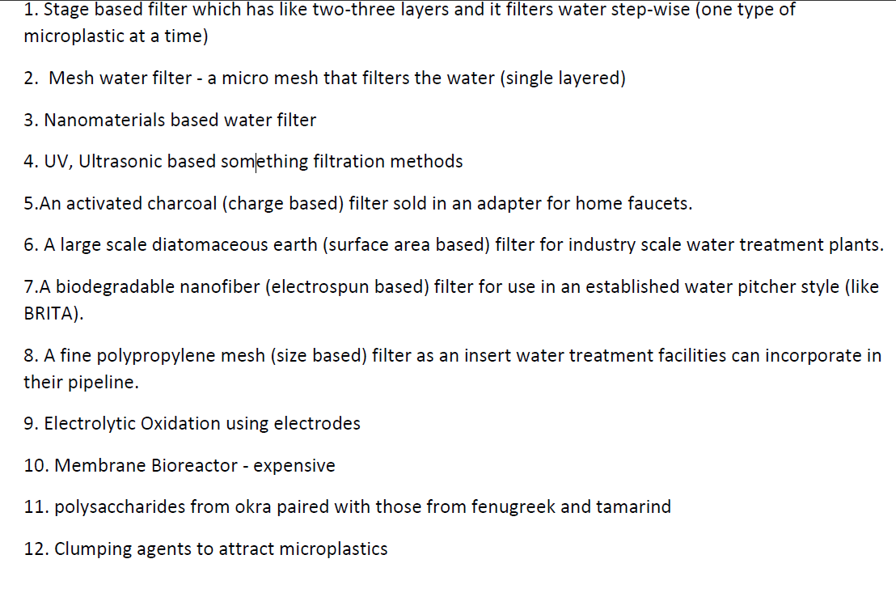
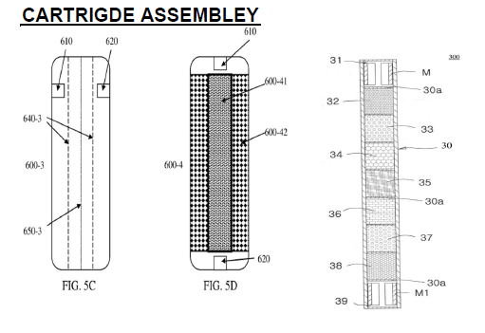
Concept Freeze

Slide 7
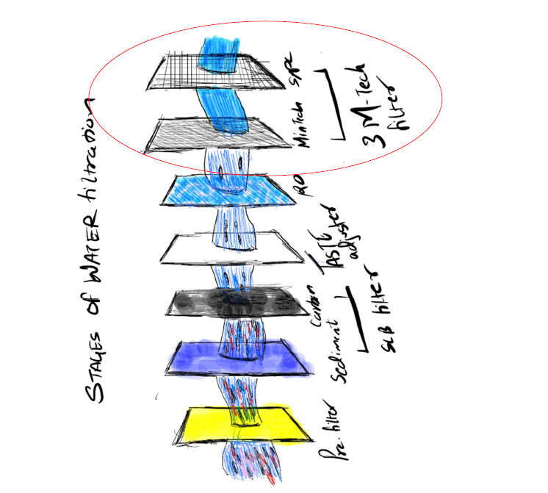
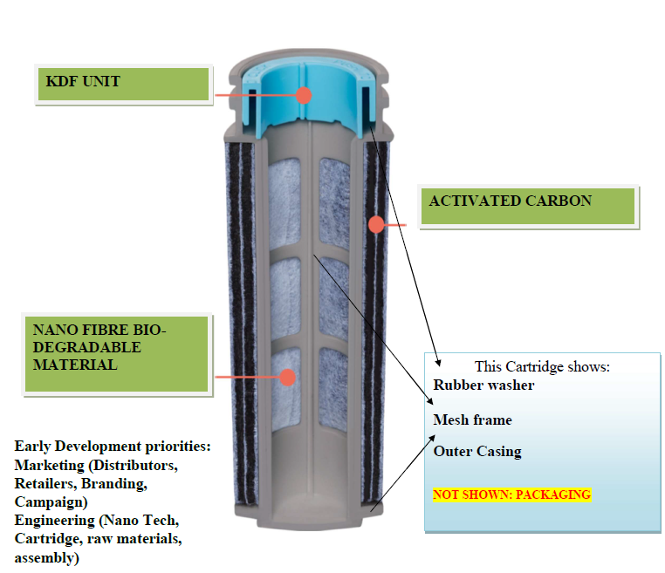
Product & Components
CORE TECHNOLOGY: Biodegradable nanofiber for microplastic filtration

Slide 8
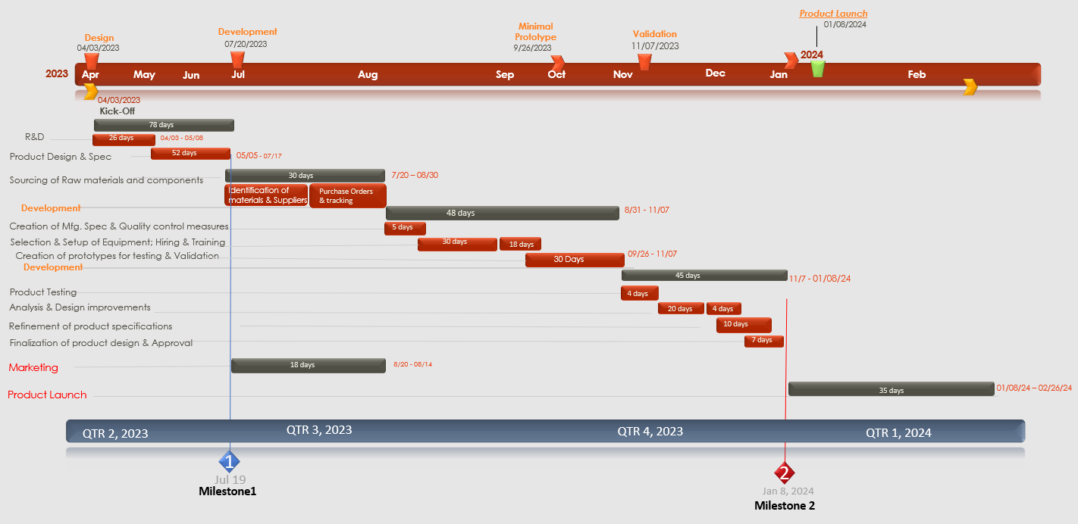
Development Plan

Slide 9
Cost Categorization
Design – $182K
Development - $176K
R & D - $29K
Creation of Product design & Spec. – $55k
Resources – $98k
Resources used: 3D modeling software, CAD programs, Sr. Product Manager, Resource lvl 3, Resource Lvl 5
Sourcing of Raw materials and components - $48k
Development of manufacturing process - $52k
Resources - $76k
Resources used: Raw Materials, Quality control tools, Hiring Manager, Resource lvl 1, Resource lvl 3, Eng. Resource Lvl 5
COST
BREAKDOWN
Validation- $100k
Marketing & Launch - $129k
Testing of prototypes – $10k
Iterative design improvements - $20k
Refinement of product design and Spec. – $10K
Resources - $60k
Resources used: Lab equipment and testing tools, 3D modeling Software, QA Manager, Sr. Product Manager, Resource lvl 3, Resource Lvl 5
Development of marketing plan and strategy - $10k
Product packaging and labeling - $25k
Distribution – $25k
Resources - $69K
Resources used: Marketing Resource lvl 3 [5], Sr. Product Manager, Design Resource lvl 1 [2]
Total Project Cost: 587K USD

Slide 10
Resource Utilization Matrix
Costs
Design
Development
Validation
Marketing
Product launch
3D modeling software, CAD programs
$8000
High
Low
Low
Low
Low
Prototype manufacturing tools & materials
$10,000
Low
High
Low
Low
Low
Laboratory equip and testing tools
$25,000
Low
Low
High
Low
Low
Raw materials and quality control tools
$50,000
Low
Low
Low
Low
Low
Product Design resource lv 3
$50/hr
High
Low
Moderate
Moderate
High
Resource Utilization
Testing resource lv 3
$50/hr
Low
Low
High
Low
Low
Engineering resource lv 5
$80/hr
Moderate
High
Moderate
Low
Low
Marketing resource lv 3
$40/hr
Low
High
High
High
High
Sr. Product Manager, Sr. QA Manager
$150/hr
High
High
Moderate
Moderate
Moderate
Hiring Manager
$90/hr
Low
High
Low
Moderate
Moderate
Manufacturing Facility
$150,000
Moderate
High
Low
Low
Low
Low – [10-25%]
Moderate – [26 – 50%]
High – [60 – 100%]

Slide 11
THANK YOU!

Slide 12
Any Questions?

